Slide 2



Etrieve Flow Administrator Training
This presentation is CONFIDENTIAL and property of Softdocs, Inc. It is to be used only for the purpose intended. Any unauthorized use is strictly prohibited. © 2017 Softdocs, Inc.

Slide 3
Agenda
Flow Administration
Creating Workflows
Actors and Activities
Differences between Content and Forms Workflows
Workflow Monitoring
Email Templates

Slide 4
Flow Administration

Slide 5
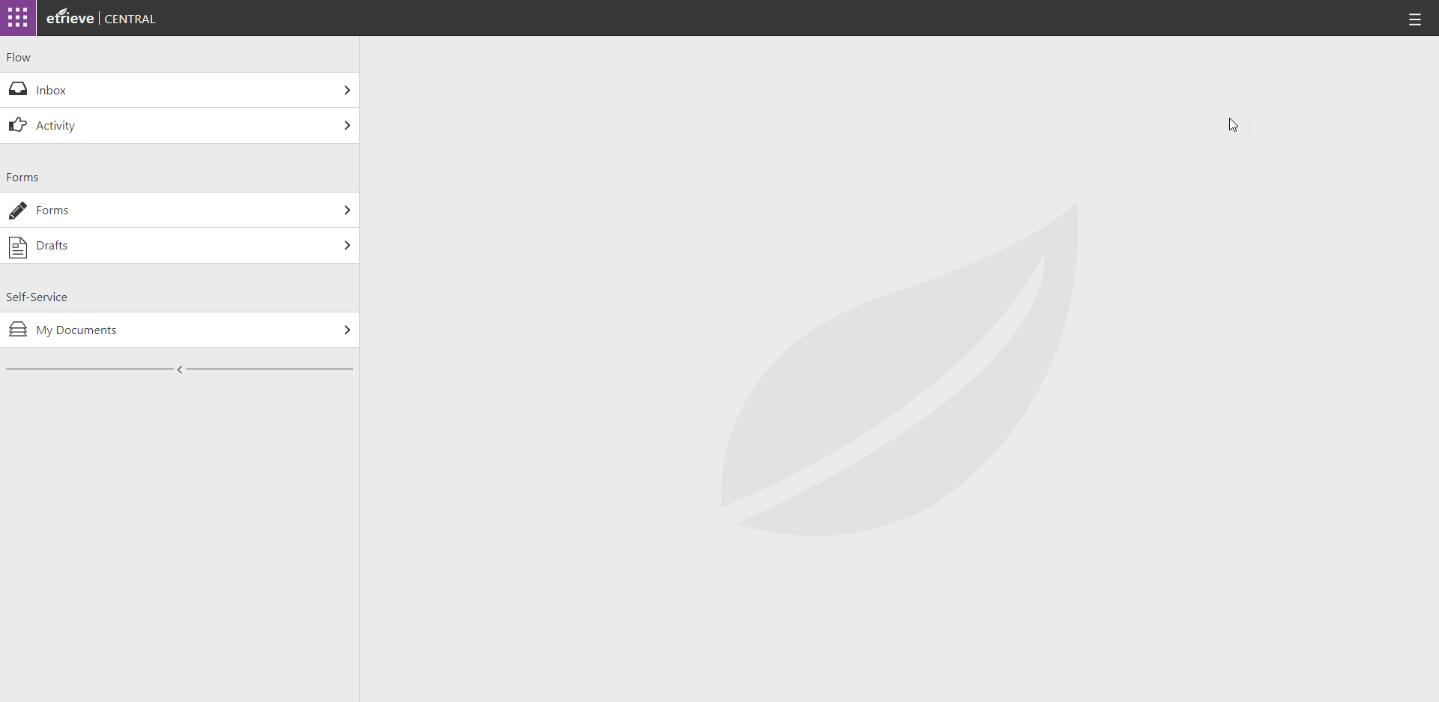
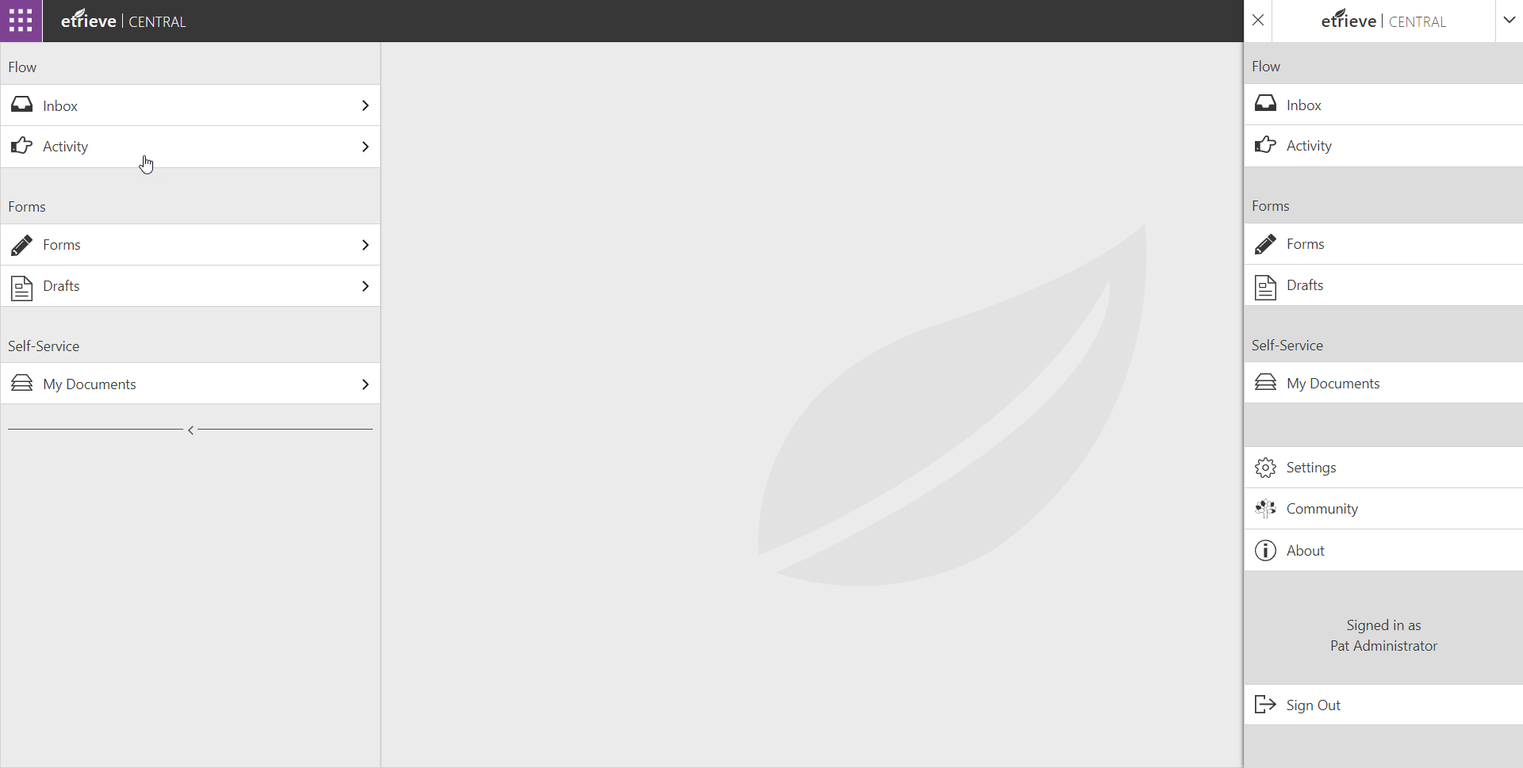
Access Central Settings
1. Click Menu Icon
2. Click Settings Tab

Slide 6
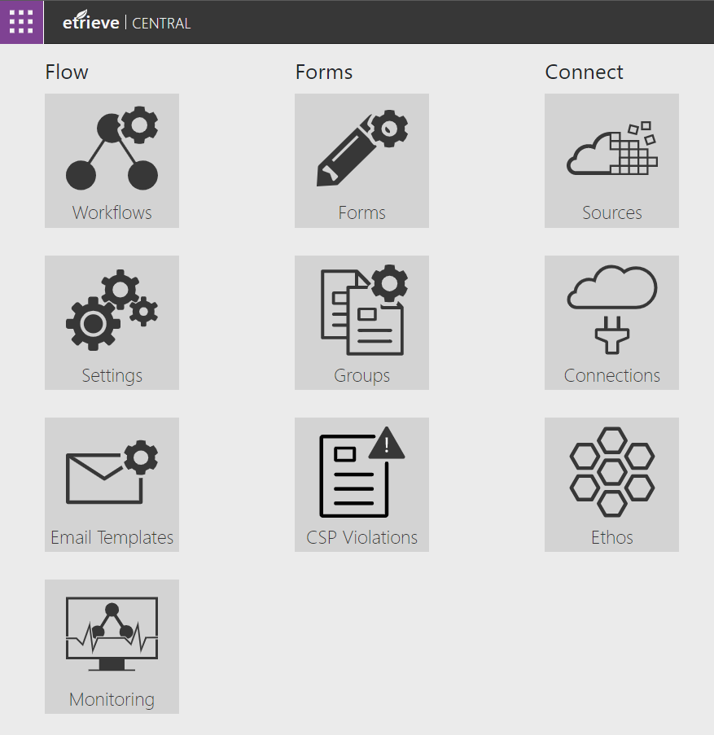
Workflow Settings
Workflow Manager
Creating and modifying workflows
Workflow Settings
Global workflow submission error information
Email Templates
Managing email notifications coming out of Workflow
Workflow Monitor
Managing workflow packages

Slide 7
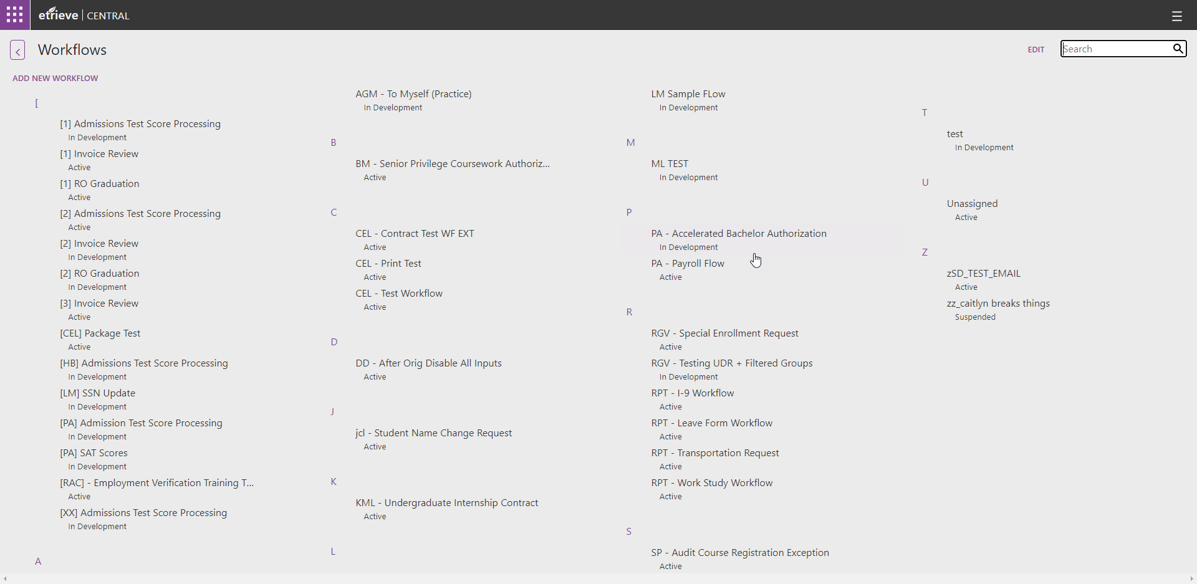
Filtering the Workflow List
The Workflow list can be filtered by entering text in the Search field

Slide 8
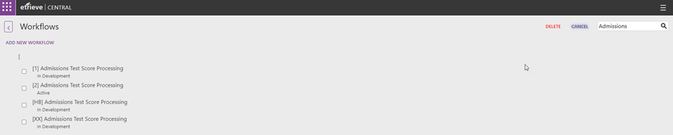
Deleting a Workflow
Click Edit
Select Workflow(s)
Click Delete

Slide 9
Creating Workflows

Slide 10
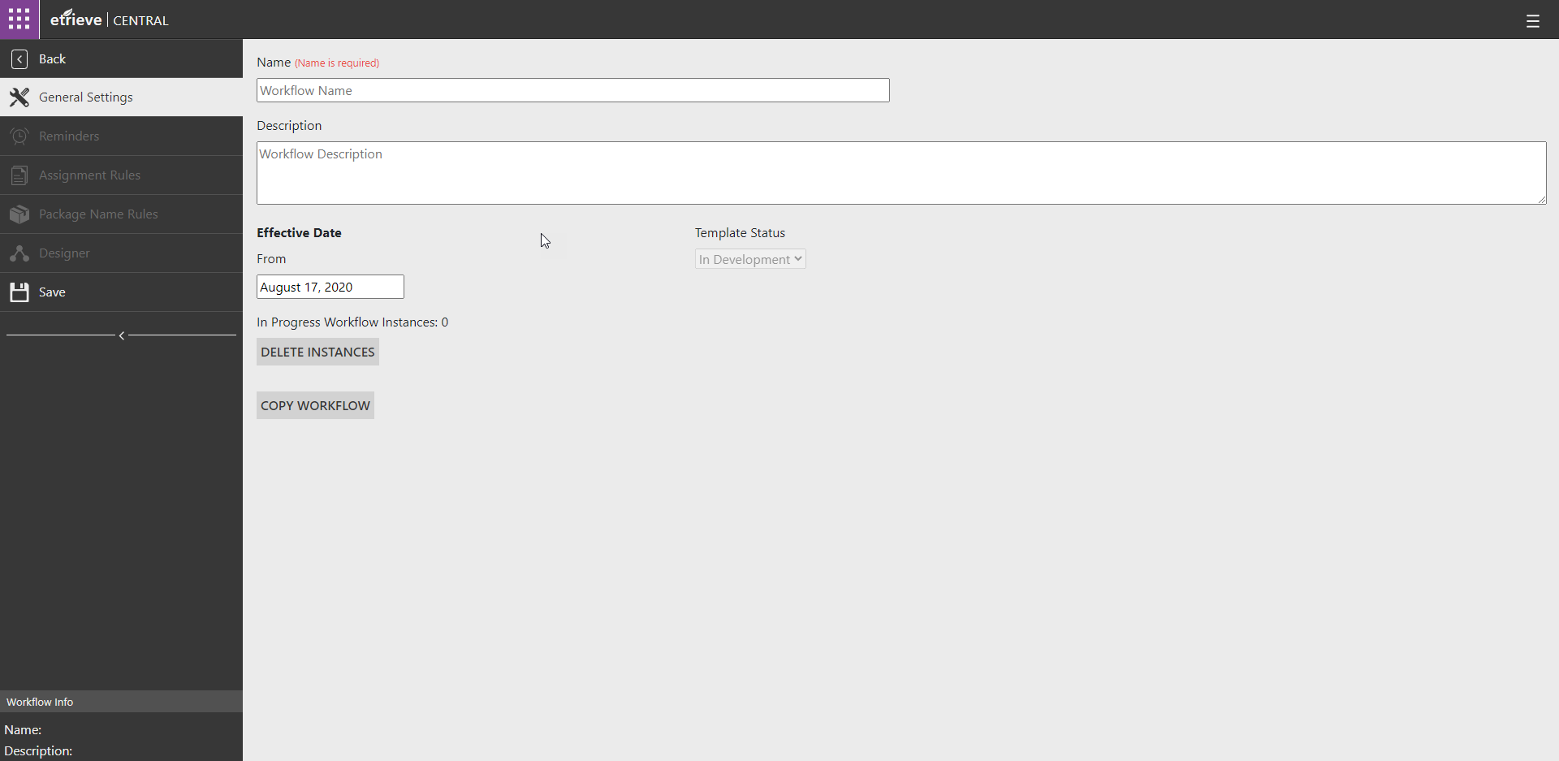
Adding a New Workflow
Click Add New Workflow
Name Workflow

Slide 11
General Settings
Workflow Name – Include Dept Prefix
Workflow Description – Include author’s initials and short WF description
Template Status – Workflow cannot be saved in “Active” status
Effective Date – Date the workflow will become enable automatically
Packages in progress
Delete all packages in progress
Copy the workflow
1
2
3
4
5
6
7
Notes:
Until a workflow has been named and saved, all other workflow manager tabs will be grayed out and inactive.
Workflow name is the name of the workflow and what will display in the workflow list
Workflow description is a description of the workflow.
Template Status is the status of the workflow
In Development – workflow has not been made active and is being developed
Active – Workflow is active and can accept Forms or Documents
Suspended – Workflow is not Active
Changes to workflows cannot be saved when the Template Status is Active
This status also displays for each workflow in the workflow list.
Effective Date
Sets date workflow will become active
Defaults to current date when workflow is created
Can be set to a future date
Even if status is Active, Workflow will not turn on until future date is reached
In Progress Instances
Number of active packages in the workflow
Delete Instances
Deletes all packages in the workflow
Recommended that this is only used in Testing.
Can be restricted by Security Permissions
Copy Workflow
Allows copying of a workflow

Slide 12
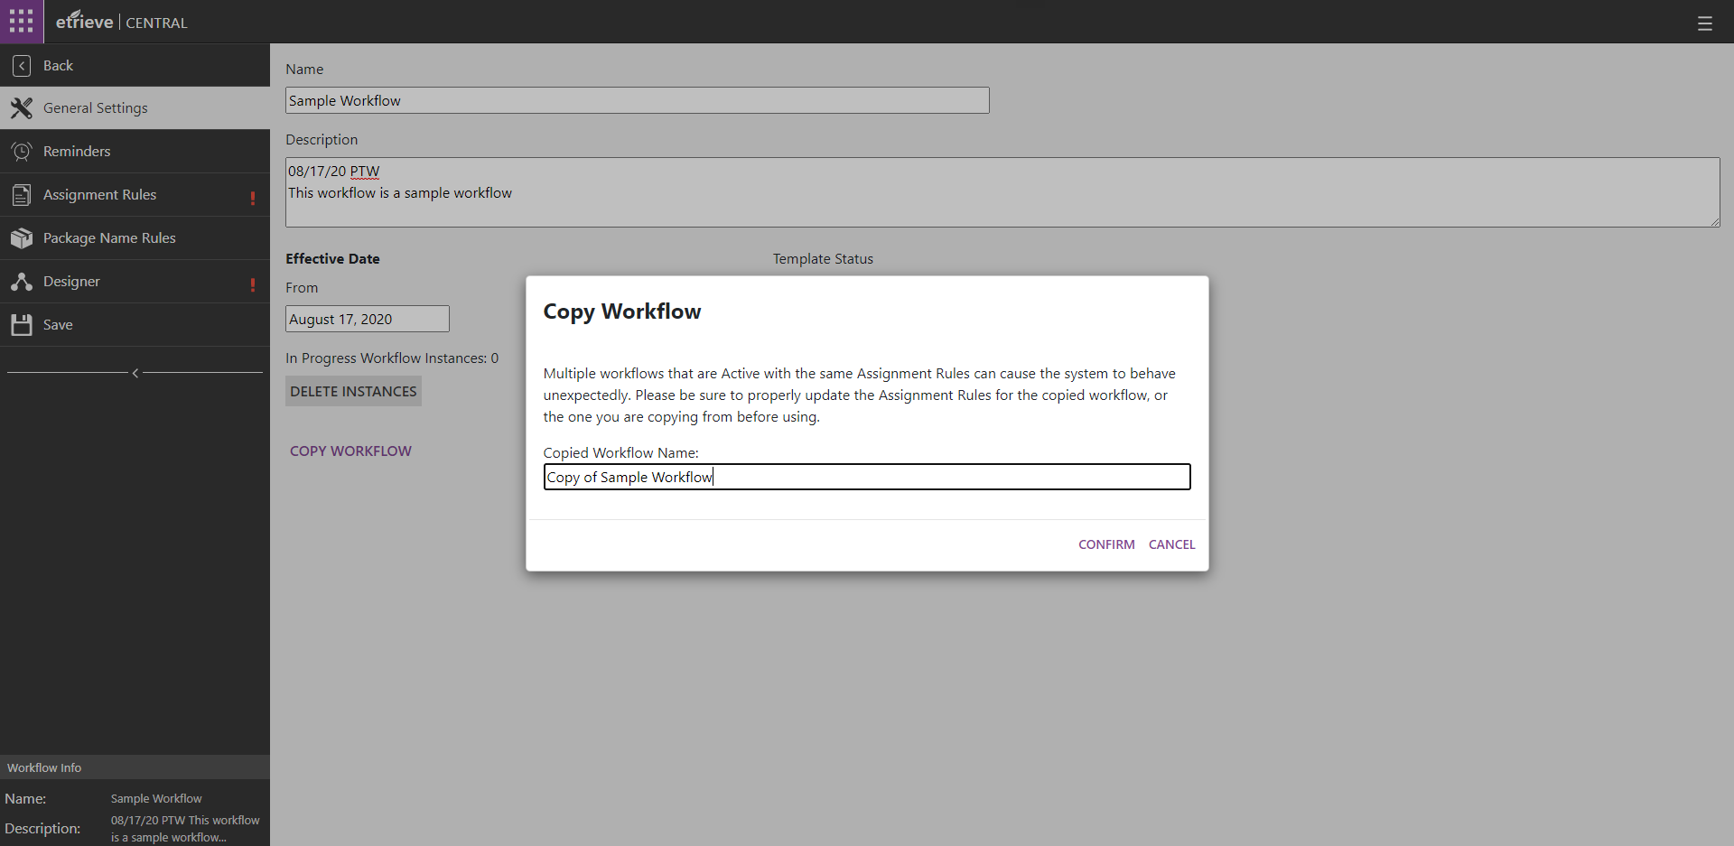
Copying a Workflow
Note: The copied workflow will keep the same Assignment Rules as the original workflow. The Template Status will be set to “In Development.”

Slide 13
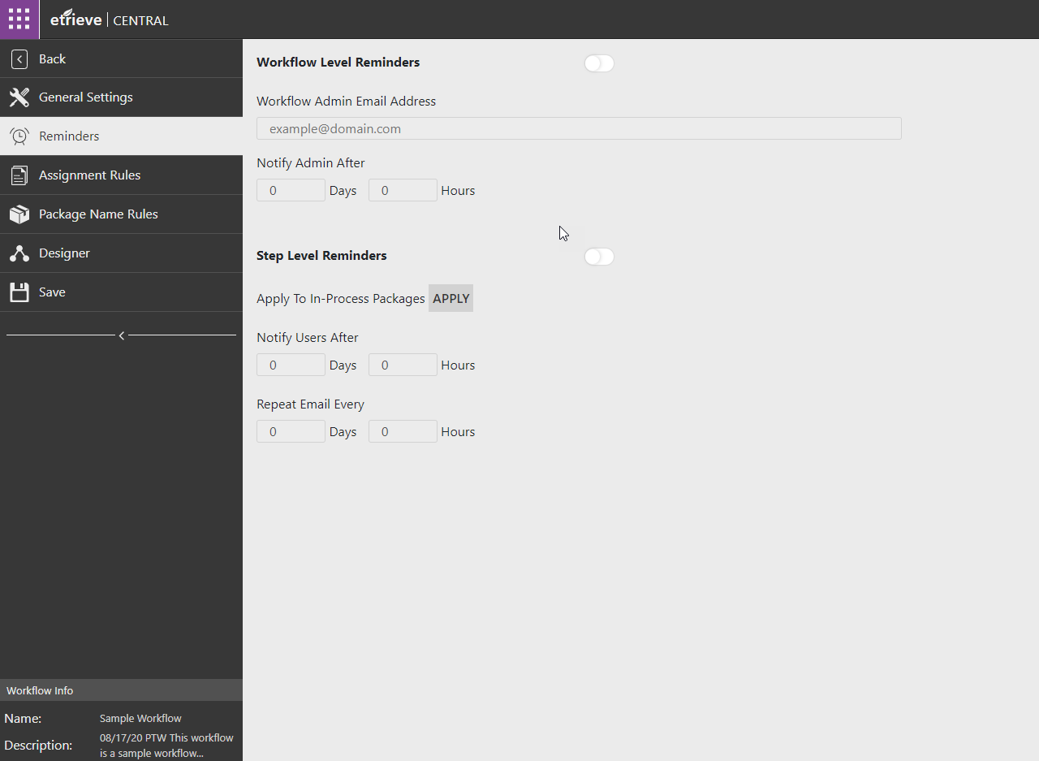
Workflow Level Reminders
Workflow Level Reminders Toggle
Workflow Admin Email
Admin Notification Time Setting
1
2
3
Note: Workflow Level Reminders will send an email to the workflow admin after a package has been sitting at the same step at any part of the workflow for the set amount of time.
Notes:
Workflow Reminders Toggle Turns on Reminders to the Workflow Administrator
Workflow Administrator Email is the address that should receive Workflow Level Reminders
Notify Admin After Time Setting determines how long packages must sit before a reminder notification is sent to the admin

Slide 14
Step Level Reminders
Step Level Reminders Toggle
Apply to in packages already in-flight
Reminder Time Setting
Repeat Reminder Time Setting
1
2
3
Note: Step Level Reminders will send a reminder notification email to the assigned actor(s) at the specified step after a package has been sitting at that step for the set amount of time.
4
Notes:
Step level reminders toggle allows Step level reminders to be set on Workflow Actors
Apply to in process packages will send reminders for packages currently in workflow
Notify Users After Setting determines how long a package must sit at a step before a reminder is sent to the users assigned to that actor
Repeat email every time setting determines how long after a step level reminder is sent that a repeat reminder should be sent

Slide 15
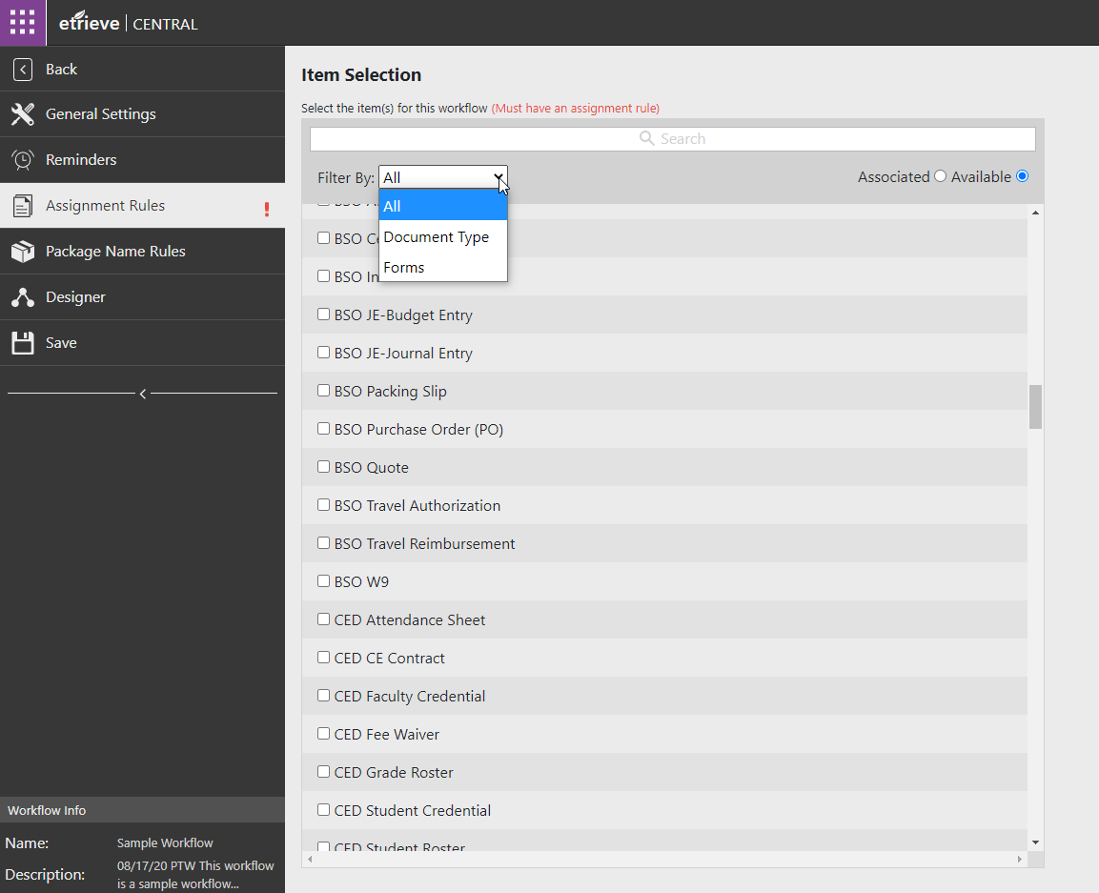
Assignment Rules
Assign the Document Type or Form to the Workflow
Note: Always be sure to filter the “Available” list of items so that you select the appropriate Document Type or Form to the Workflow
Notes:
Assignment Rules determine which Forms or Content Documents are associated with the Workflow
Available Forms and Documents can be filtered using the filter by drop down
Associated and Available Forms and Documents can be filtered by entering text into the Search Field
Multiple items can be associated with the same workflow, but at least one item MUST be associated with a workflow for it to be made active.

Slide 16
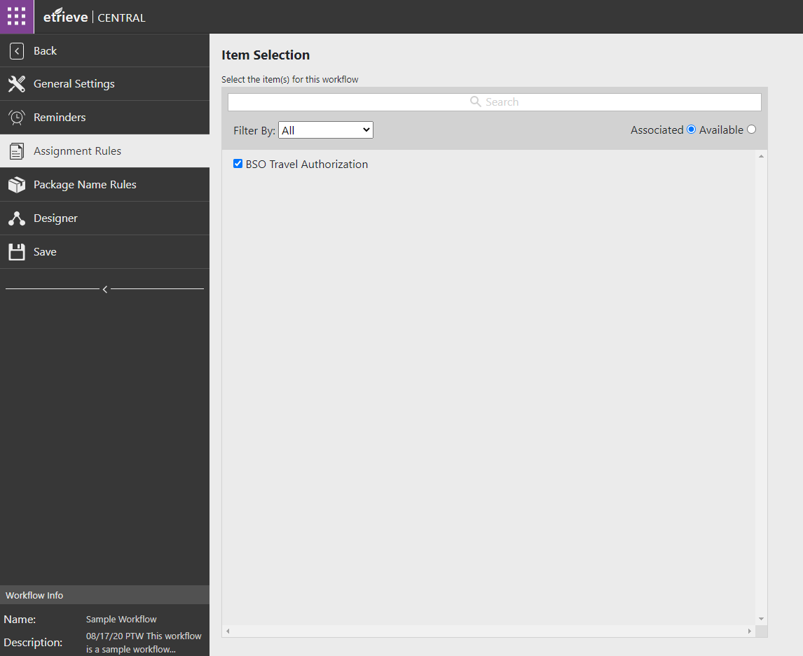
Saving Changes
All changes to Workflows must be saved by clicking the Save button
Note: Changes cannot be saved to Workflows with an Active Template Status. Set Template Status to In Development or Suspended to save changes after a Workflow is activated

Slide 17
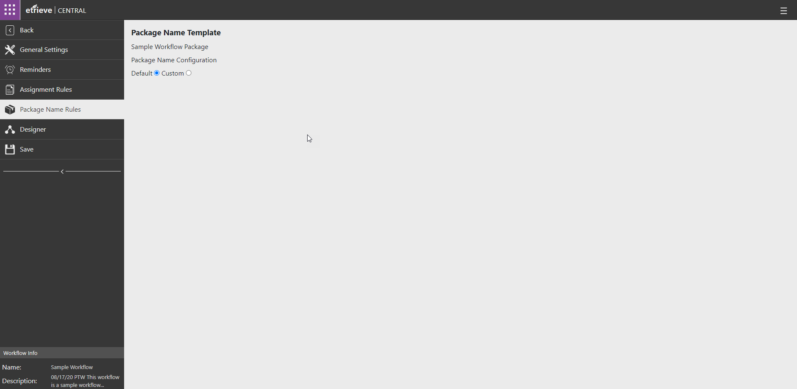
Package Name Rules - Default
Default Package Name will be the name of the Workflow with “Package”

Slide 18
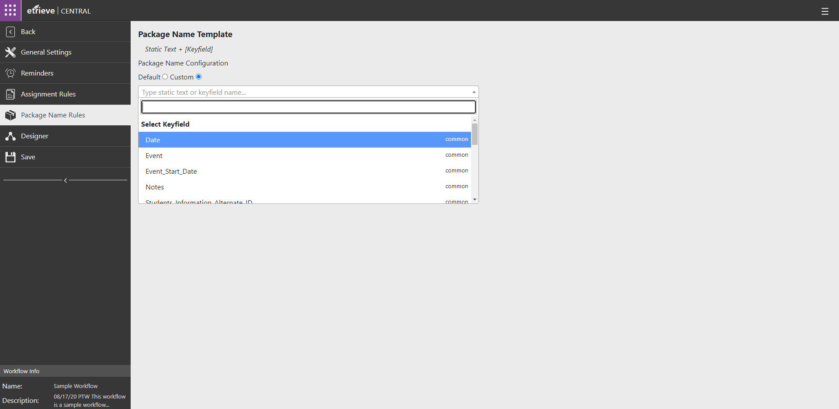
Package Name Rules - Custom
Selecting Custom allows the use of Static Text and Key Fields to create more meaningful package names
If Content Documents are associated to the Workflow, the Document’s Key Fields can be used in the Package Name
If Forms are associated with the Workflow, the Form’s Input (green) Fields can be used in the Package Name

Slide 19
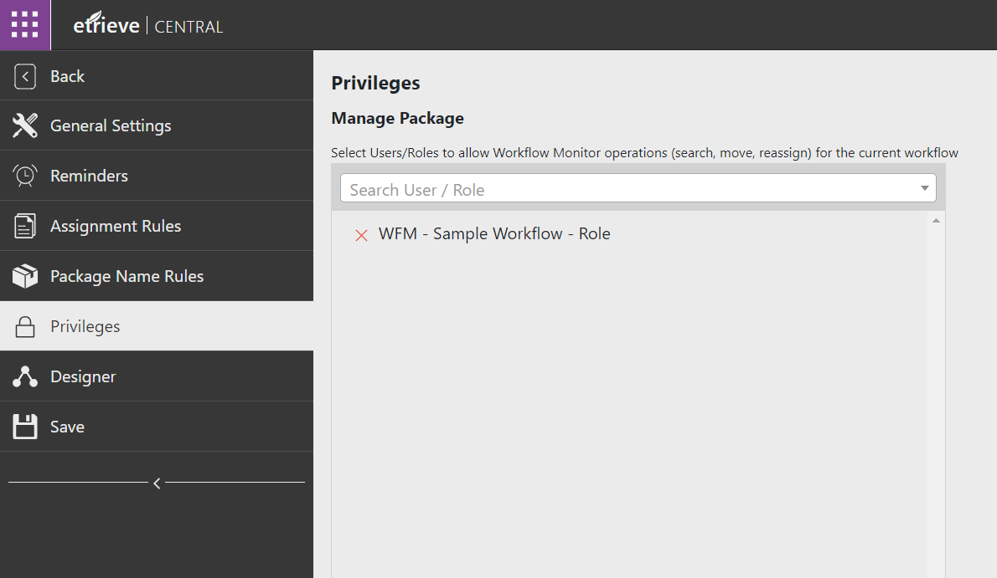
Privileges for Workflow Monitor
Select a User or Role to assign the privilege for using the Workflow Monitor.
This will allow users to use the Workflow Monitor without Central administration privileges.
Workflow Monitor allows users to:
Move live packages along the workflow to another step (forward or backwards)
Reassign a package at a certain step
Note: Best Practice to apply privileges to a Role and apply the Role to a Group in Security.
Note: This privilege can also be applied through Etrieve Security.

Slide 20
Workflow Design & Actor Configuration

Slide 21
Workflow Designer
Three Workflow Components
Actors
Users interacting with Workflow Packages
Activities
Actions executed by the Workflow
Navigation
Determine Package routing path

Slide 22
Actors and Activities

Slide 23
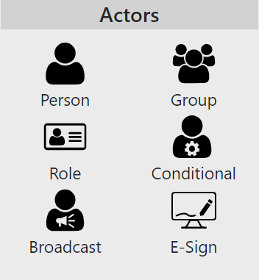
Actors
Person/Group/Role
Assigned from Security
Group is recommended
Conditional
User/Group/Role
Uses Integration
Broadcast
Send Forms to Users to complete
Uses Integration
E-Sign
Sends Form to User outside of Institution
Requires email of signee on Form

Slide 24
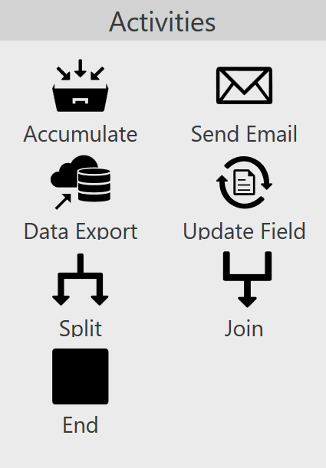
Activities
Accumulate
Collects multiple items before advancing
Send Email
Sends email to specified address
Update Field
Updates Content Key Field
Data Export
Exports Form data via integration
Splits and Joins
Routes Packages to multiple Actors at the same time and joins the packages back up
End
At least one End Activity is required in a Workflow

Slide 25
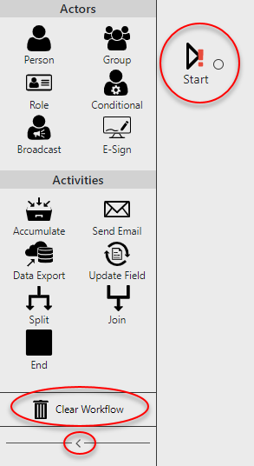
Workflow Design Basics
All Workflows begin with a Start Activity
Forms
Originator (initial submitter)
Content Documents
System User
Clear Workflow
Deletes entire Workflow
Panel Collapse Button
Minimizes Actors and Activities Menu
All steps except End Activity must have an input and output path
A red exclamation mark indicates a step does not meet its configuration requirements

Slide 26
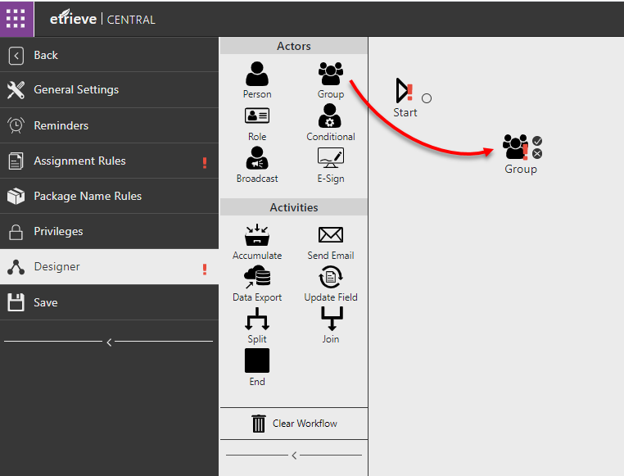
Adding an Actor
To add an Actor to a Workflow, click on the Actor in the Actors list and drag the Actor to the Workflow

Slide 27
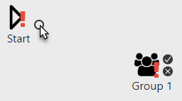
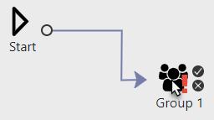
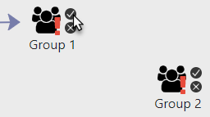
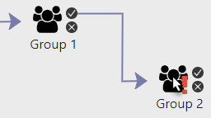
Adding Navigation
To add Navigation between two steps, click and drag the Navigation path from one starting point to another.
Approval paths start at the “check” Navigation path
Decline paths start at the “X” Navigation path
Declines are represented by a yellow Navigational path

Slide 28
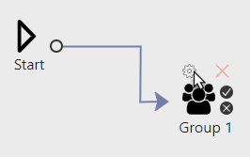
Configuring an Actor
To access an Actor’s configuration, hover over the Actor in the Workflow and click on the gear that appears over the Actor
Clicking the red “X” that appears over the Actor will delete it from the Workflow

Slide 29
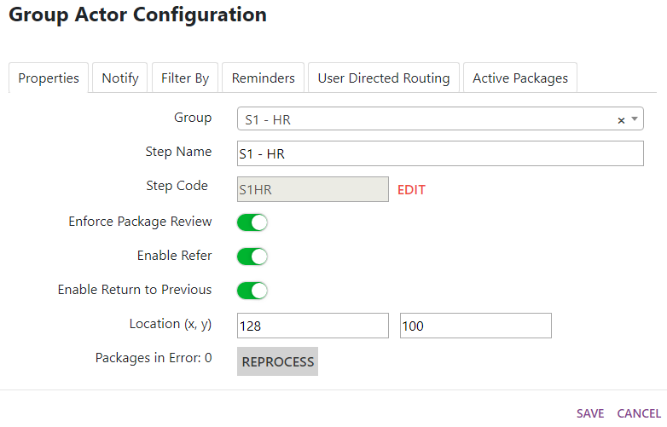
Group Properties
Group
Assigns a Security Group to the Actor
Step Name
Allows for a more meaningful Step Name viewable in the workflow designer
Step Code
Allows for a more meaningful database name for the Step
The Save button must be clicked on the Step Configuration AND the Workflow Designer to preserve any changes

Slide 30
Group Properties
Enforce Package Review
Requires Users to view all Package Contents before acting
Enable Refer
Allows User to send Package to any User in the system for Approval
Enable Return to Previous
Allows User to return Package to a previous Actor
Location
The X and Y coordinates of the Step in the Workflow
Packages in Error displays the number of any Packages that have errorred at the current step. Clicking Reprocess will attempt to reprocess the packages

Slide 31
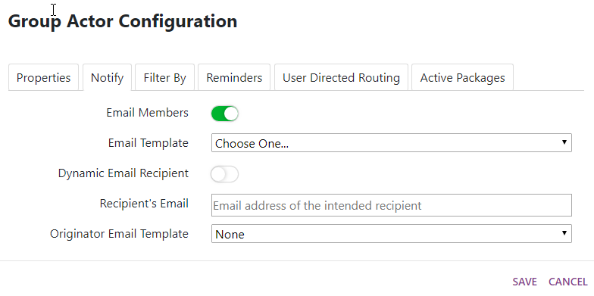
Group Notifications
Email Members
All members of Group are emailed when a Package is Received
Email Template
Specifies the email the Dynamic Recipients receive
Dynamic Email Recipient
Allows selection of a Form or Document Field containing an email address to receive notification
Recipient’s Email
(Dynamic off) Specifies the recipient’s email address
(Dynamic on) Specifies the Field containing the recipient’s email address
Originator Email Template
Specifies the email the originator receives
Can only be used with Form Workflows
If no template is specified, the originator will not be notified

Slide 32
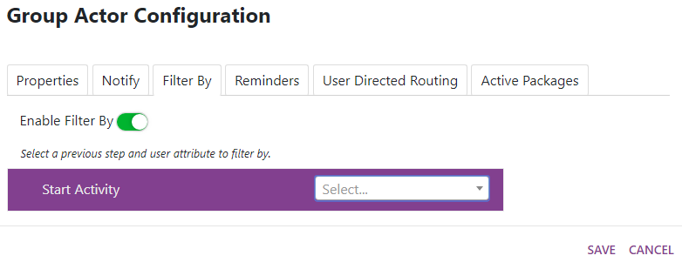
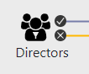
Group Filtering
Enable Filter By
Uses Security Custom Properties to route Packages to Specific Group Members
Group Member must have same Custom Property as Originator
Typical Use Cases
Filtering by Department
Filtering by Location
When Group Filter is enabled, the filter icon will display on the group actor in the workflow
Filter By enabled

Slide 33
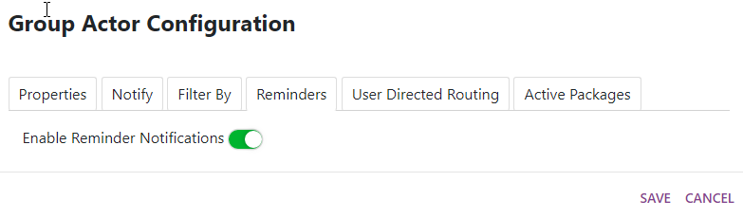
Group Reminders
Enable Reminder Notifications
Activates Step Level Reminders
Configured on Reminders Tab

Slide 34

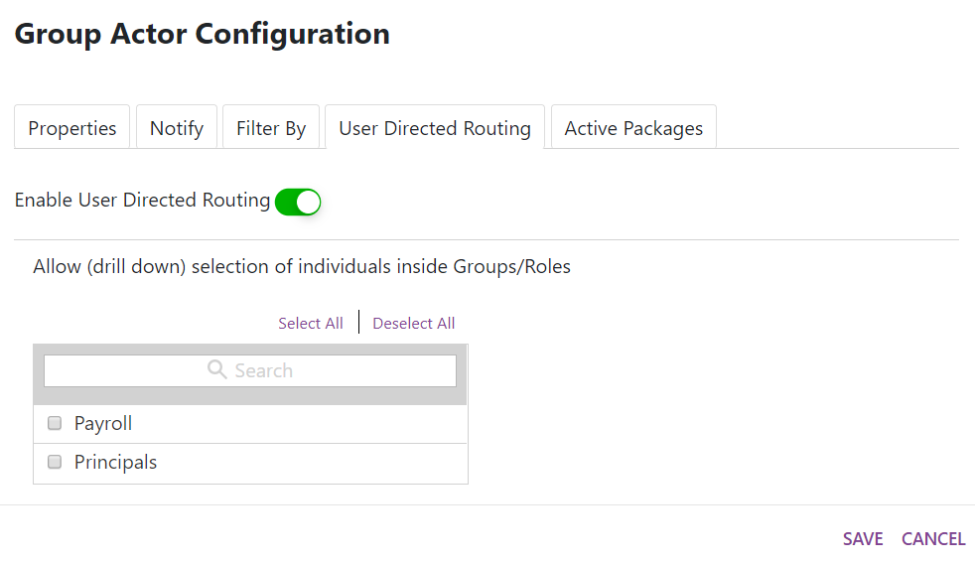
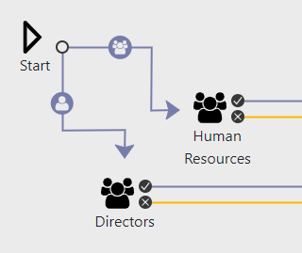
Group User Directed Routing
Enable User Directed Routing
Allows User to choose destination of Package
Also known as UDR
Allow drill down selection
Allows User to select specific Users or Group to deliver Package to
When UDR is active, connectors will display a UDR icon in the Workflow
Allow drill down off
Allow drill down on
Note: When UDR is turned on at a step, any navigational rules applied on route to the next workflow step will be ignored.

Slide 35
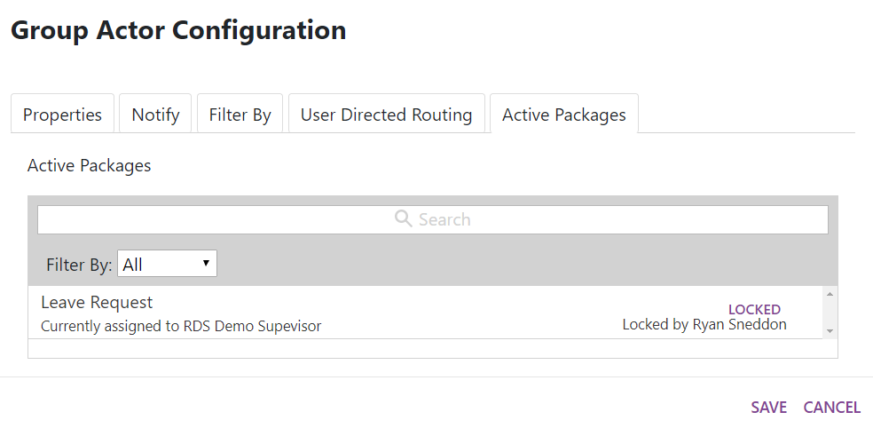
Group Active Packages
Active Packages
Shows all packages in Actor Inbox
Shows if Package is Locked or Unlocked
Shows which User Package is Locked by
Allows Administrator to Unlock Packages
Click on LOCKED to Unlock Package
Text can be entered in search field to find specific Packages
Filter By dropdown allows filtering by Locked, Unlocked, or all Packages

Slide 36
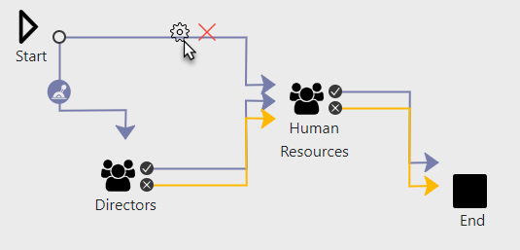
Navigation Rules
Navigation rules specify Package routing based on Form or Document Field values
To access a Connector’s Navigation Rules configuration, click on the Connector and then click on the Gear that appears above the Connector
When a Connector has Navigation Rules configured, an icon will display on the Connector in Workflow

Slide 37
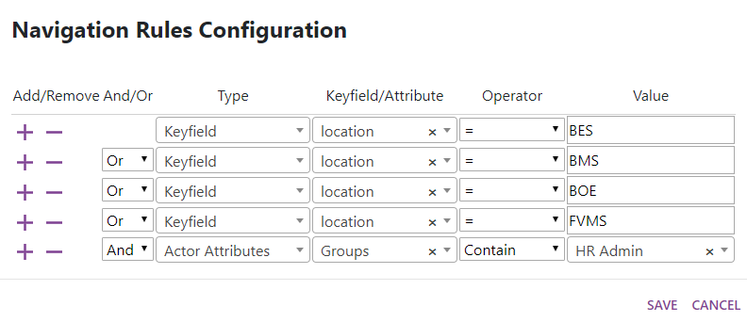
Navigation Rules Configuration
Can use Field values or Actor Attributes
Actor Attributes are Security Groups or Roles assigned to Users
Can use compound logic
Multiple conditions
AND and OR logic
Logic cannot be nested
When using Navigation Rules each path must have mutually exclusive conditions
A Package can only pass one set of rules or it will get stuck

Slide 38
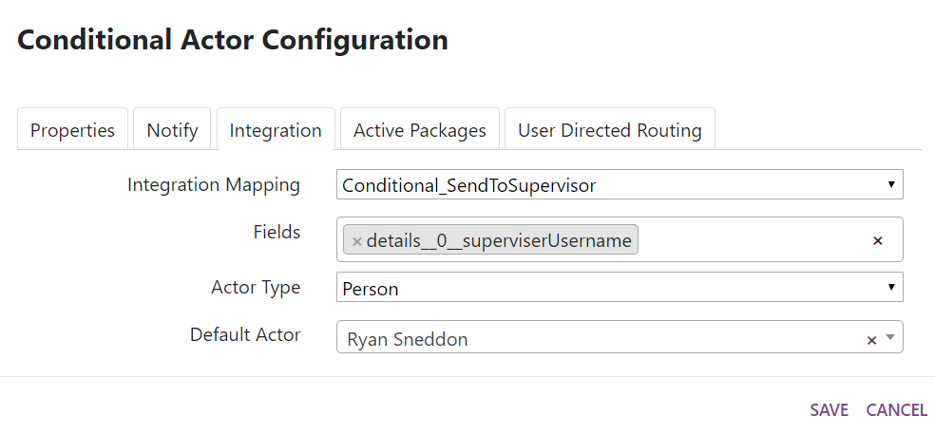
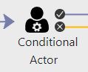
Conditional Actors
Assigns Recipient based on input value
Uses integration
Integration Mapping
Specifies which Integration Source to use
Fields
Specifies which field to use for input value
Actor Type
Type of recipient actor
If routing to Person must use Etrieve Login ID
If routing to Group or Role must use Principal ID
Default Actor
Actor the Package is routed to if integration returns no result
Note: Integration Source query must return a single value in order to successfully route the package to the specified Actor.

Slide 39
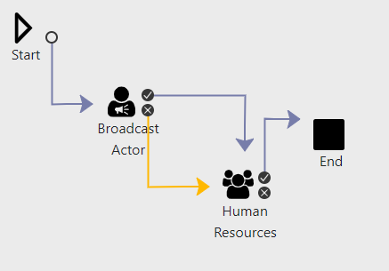
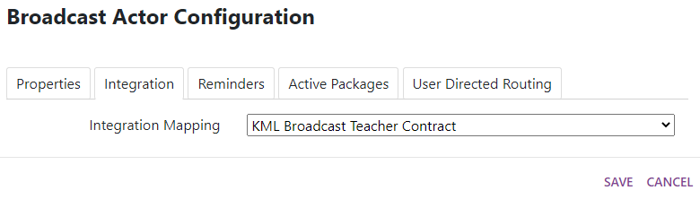
Broadcast Actors
Broadcast Actors can only exist after the Start step
Uses integration
Integration Mapping
Specifies which Integration Source to use
Note: Integration Source query must return values that match the Etrieve Email address in order to accurately assign the form’s values to the recipient.

Slide 40
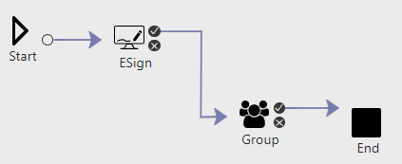
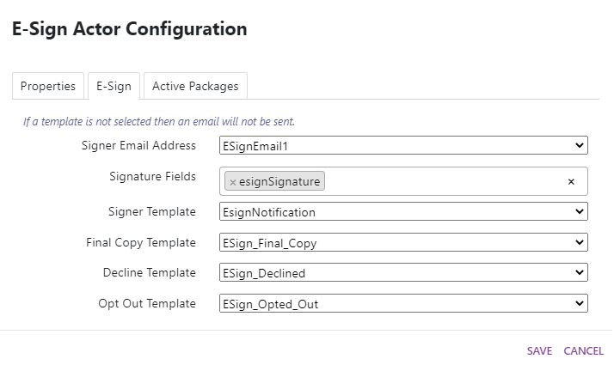
E-Sign Actors
Send a form to a user outside of the institution
Requires Email of signee on the form
User receives Email with link to form to sigh
Select fields required for signing for the E-Sign step
Signee has ability to approve, decline, or opt-out of signing
Opting out will not progress the package forward through the workflow
Note: After the E-Sign step, the form fields cannot be edited. All input fields are disabled.
Note: Sending the package back to an E-Sign step will clear out all required fields filled out by the signee.

Slide 41
Activity Configuration

Slide 42
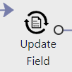
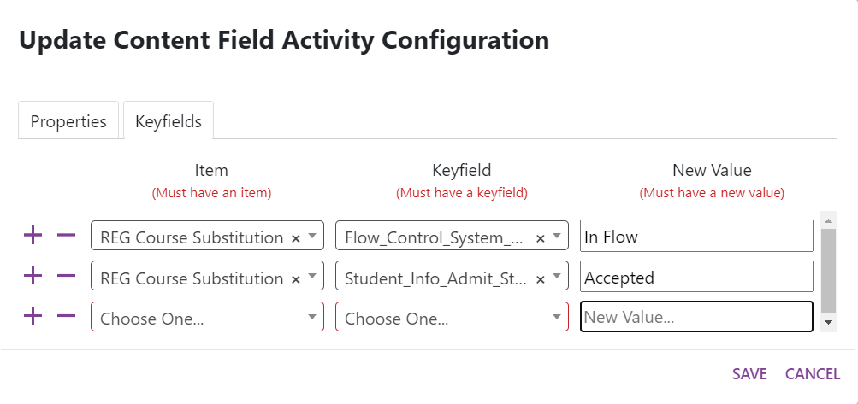
Update Field Activity
Can only be used in Content Document Workflows
Item
Specifies Content Document Type
Key Field
Specifies Key Field to update
New Value
Static value to update Field value

Slide 43
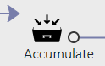
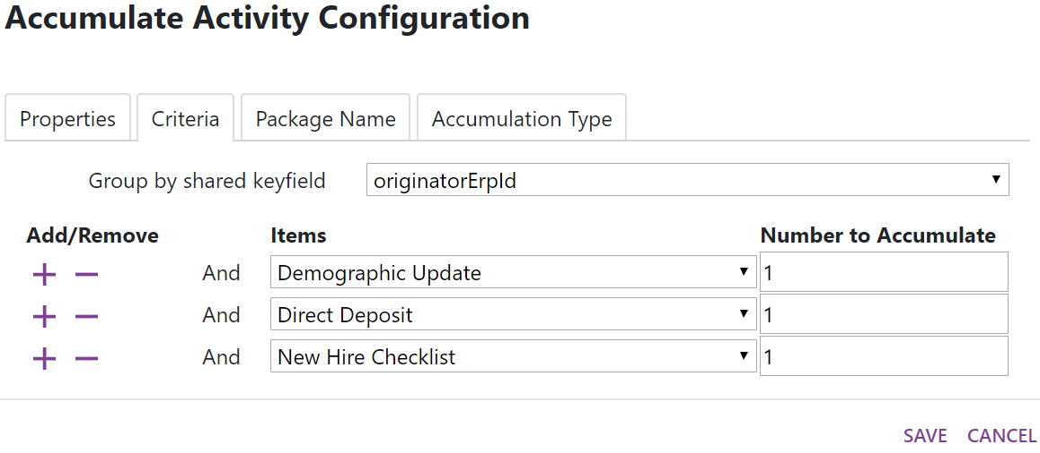
Accumulate Activity Criteria
Allows combining multiple Forms or Documents into a single Package
Group by shared keyfield
Specifies Field to use to combine documents
Can only specify a key field that is shared among all assigned Forms or Document Types
Item
Specifies Form or Document Type
Number to Accumulate
Specifies the number of each Form or Document Type to collect before combining and forwarding Package

Slide 44
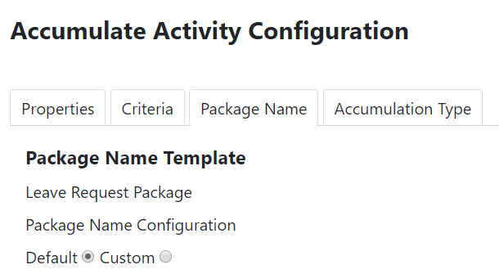
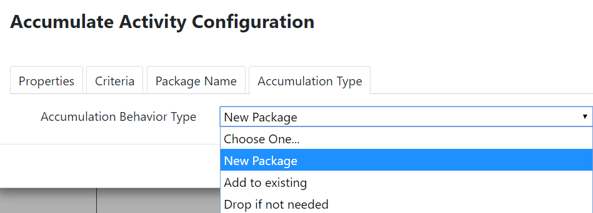
Accumulate Activity Name and Type
A new Custom Package Name for the combined Package can be defined on the Package Name tab
The Accumulation Type specifies what should be done when new matching items enter the Workflow.
A new Package can be created, the item can be added to an existing Package still in flight, or the item can be dropped and ignored.

Slide 45
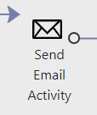
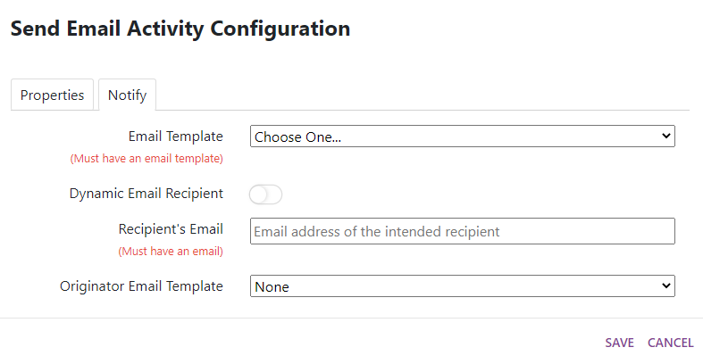
Send Email Activity
Sends email to specified address
Email Template
Specifies what email the Recipient should receive
Dynamic Email Recipient
Allows selection of a Form or Document Field containing and email address to receive notification
Recipient’s Email
(Dynamic off) Specifies the recipient’s email address
(Dynamic on) Specifies the Field containing the recipient’s email address
Originator Email Template
Specifies the email the originator receives
Can only be used with Form Workflows
If no template is specified, the originator will not be notified

Slide 46
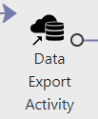
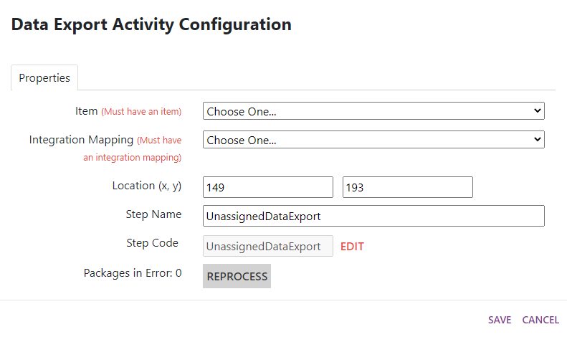
Data Export Activity
Can only be used for Form assigned Workflows
Allows export of Form Input (green) field values to database table
Item
The Form to export data from
Integration Mapping
The Integration Source to execute the export
Will only utilize Source Action types of Add

Slide 47
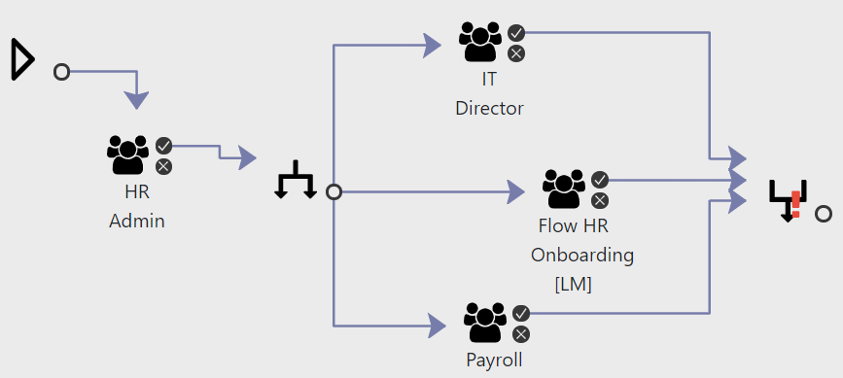
Split and Join Activities
Split
Allows routing Package to multiple Actors simultaneously
Join
Prevents Package from moving forward until all Split Packages have been acted on
Will only join the number of packages that match the number of Navigation arrows connected to it
Note: Users should have separate items to complete on the form or they may overwrite each other’s entries

Slide 48
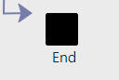

End Activity - Notify
All Workflows MUST have at least one End Activity
Multiple End Activities can be used
Originator Email Template
Specifies email Originator receives when Workflow is complete
If no Template is specified, Originator will not be notified

Slide 49

End Activity – Export (Forms Only)
Allows Form to be exported to a directory
Default Configuration
Global configuration for the Workflow’s exports
File Export Location
The directory path to the export folder
Document Type Name
The name of the Document Type the Form should be filed as in Content
Include History
Includes Workflow History and Comments as separate pages of the exported Form
Include Attachments
Includes any attachments to the Form as separate pages of the exported Form
Enable Export
Activates exports on the End Activity
Notes:
Exported Forms will need to have an import configured in Content to be imported and filed automatically.

Slide 50

Finished Workflow Example

Slide 51
Content vs Forms Workflows

Slide 52
Content vs Form Workflows
Content Workflows
Require Automation in Content to Send Trigger Documents to Workflow
Cannot use Broadcast Actor
Cannot use Data Export Activity
Workflow history is not shared in Content
Forms Workflows
Cannot Use Update Field Activity
Require Export on End Activity to be sent to Content
Require Content Import to be imported into Content

Slide 53
Workflow Monitoring

Slide 54
Workflow Monitor
Workflow Monitor can be accessed by clicking the Monitoring tile

Slide 55
Workflow Monitor
Workflow Monitor displays the status of Packages currently in Workflows
Displays detailed information for each package
Allows Moving and Reassignment of Packages
Allows inclusion of reason for moving or reassignment

Slide 56

Workflow Monitor
Search Field
Results Filters
Batch Actions
View Toggle
Results List
1
2
3
4
5

Slide 57

Search Options
Packages can be searched for by:
Package Name
Assignee
Workflow Name
Submission Date
Package Item Name

Slide 58

Search Result Filters
Results can be filtered by:
Status
Workflow Name
Workflow Step
Assignee
Date Range
Time in Workflow

Slide 59

Package Details
Clicking on a row will open the details of that workflow package

Slide 60

Alternate Results Display
Clicking on the Display selector will provide the user with a different view of the results

Slide 61

Batch Actions
Select Move or Reassign from the Batch Actions dropdown

Slide 62

Batch Actions
Select Packages
Select new Step or Assignee
Indicate Reason for Action
Confirm Action

Slide 63

Moving an Individual Package
Individual Packages can be moved to a different actor step or End step of the workflow

Slide 64

Reassigning an Individual Package
Reassigning takes all selected packages and reassigns to the specified actor in the workflow.
This does not move the package in the workflow.

Slide 65
Email Templates

Slide 66
Email Templates
Creating and modifying Email Templates can be accessed by clicking the Email Templates tile

Slide 67
Email Templates
Email Templates for Workflow Notifications.
Utilizes Keys to customize the email based on workflow actions, Package’s Name, or the Package Item’s key fields.
System generated Email Templates cannot be modified nor deleted – only copied.

Slide 68


Creating Email Templates
Setup Email Template Names that are recognizable by the Workflow and a prefix of the relating department

Slide 69

Email Templates
New Special Enrollment Request
The following student has submitted a new Special Enrollment Request: Chris Bacon 10000192.
You can view this form here: https://sdnvcentral.etrieve.cloud:443/#inbox/308b7763-cd60-4d82-ad28-3b320b221db7
Click “Show” to display the list of Email Template keys

Slide 70

Email Templates
New Special Enrollment Request
The following student has submitted a new Special Enrollment Request: Chris Bacon 10000192.
You can view this form here: https://sdnvcentral.etrieve.cloud:443/#inbox/308b7763-cd60-4d82-ad28-3b320b221db7
Click the email template key to copy the code into your clipboard.

Slide 71


Copy Email Templates
Copy Email Templates by clicking on the “Copy” button found below the Body of the Email Template
Enter a new name for the copied Email Template and press “Confirm”

Slide 72

Thank You!

